Slide 1
HOMECINE

Slide 2
streaming web-application
MENU
ANALYSIS
CONTACT
Group 1 - present
video
Get Started
Instructor: mr. nguyen the hoang
Group 1 – se1629

Slide 3
Our team
MENU
ANALYSIS
CONTACT
Viên Quốc Bình (Leader)
Nguyễn Trung Hiếu
Luân Tường Vy
Vũ Anh Thuyên
Phạm Hồ Minh Huy
Châu Tấn Tài
Nguyễn Bảo Trân
Vũ Văn Mạnh
Vũ Thị Ngọc Mai

Slide 4
TABLE OF CONTENT
background
Competitors
01
02
opportunity
Business goals
03
04
MENU
ANALYSIS
CONTACT
What the situation was
Who we will compete
How we can succeed
What we expect

Slide 5
background
MENU
ANALYSIS
CONTACT
Background
01
The successes of many video on demand (VOD) services due to COVID-19 pandemic. How does it happen?

Slide 6

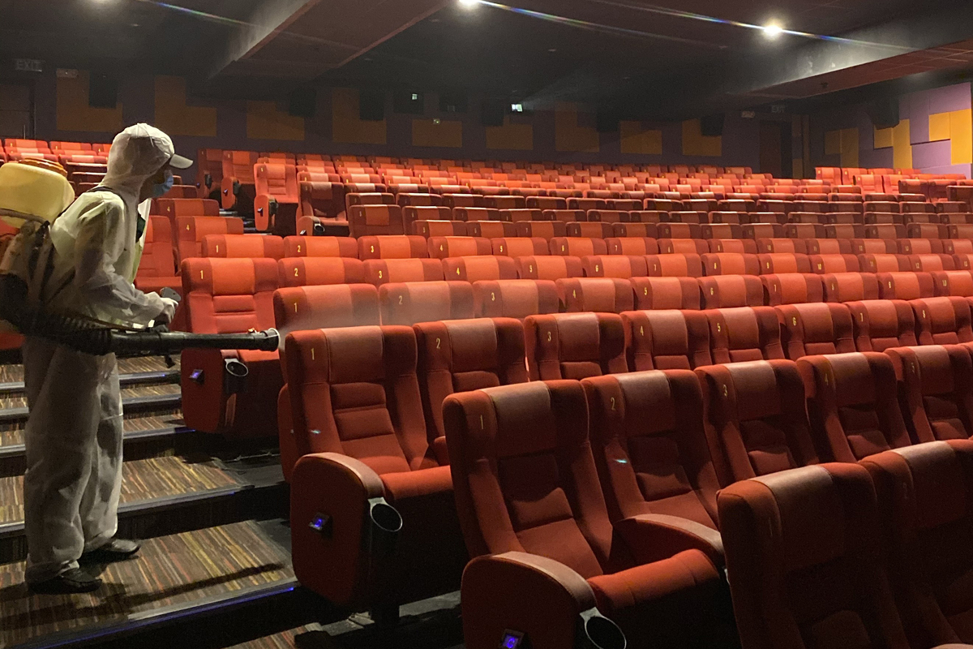
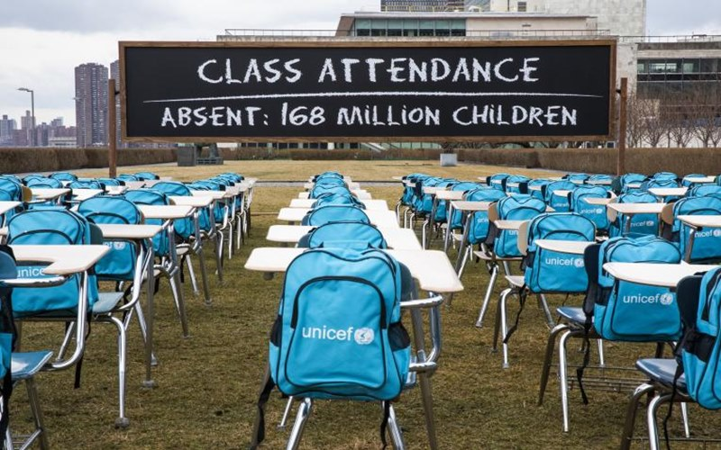

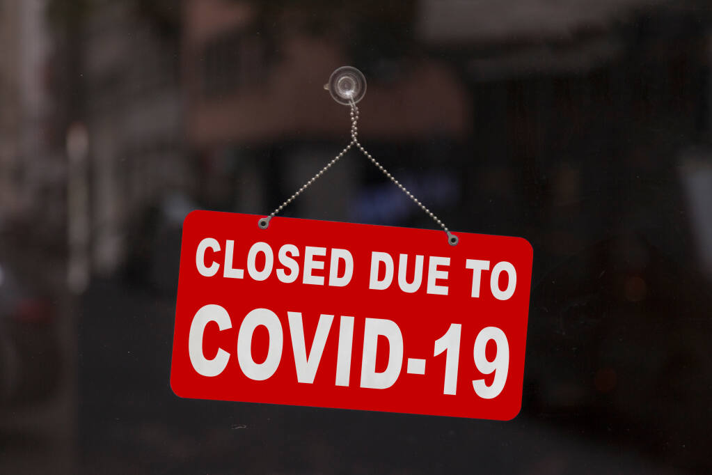

Covid-19 situation
MENU
ANALYSIS
CONTACT
background
Development of many video on demand (VOD) services, on different devices.

Slide 7

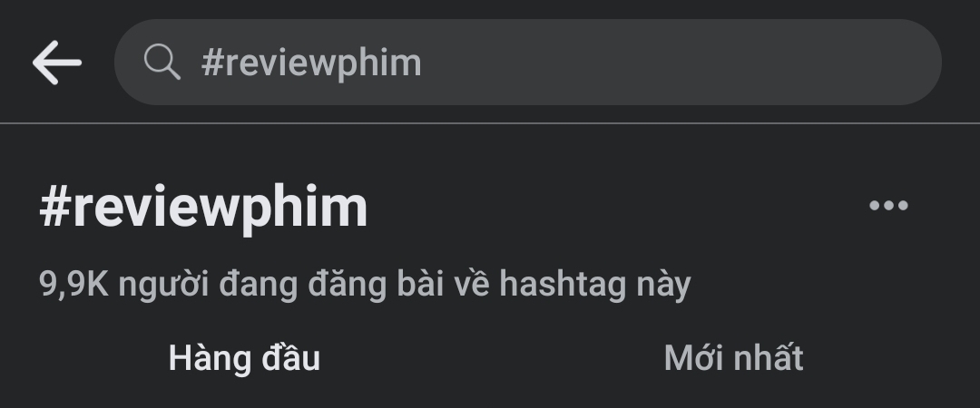

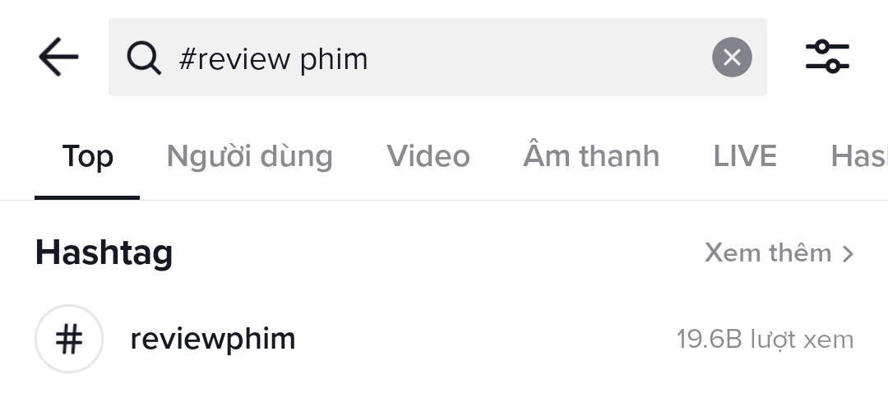

How films are viral today?
MENU
ANALYSIS
CONTACT
background
#trending
Based on Vietnam Investment Review statistics, the Vietnamese spend an average of 6 hours 47 minutes per day on surfing the Internet, approximately 39% of which is for streaming services such as movie, video, and news.

Slide 8
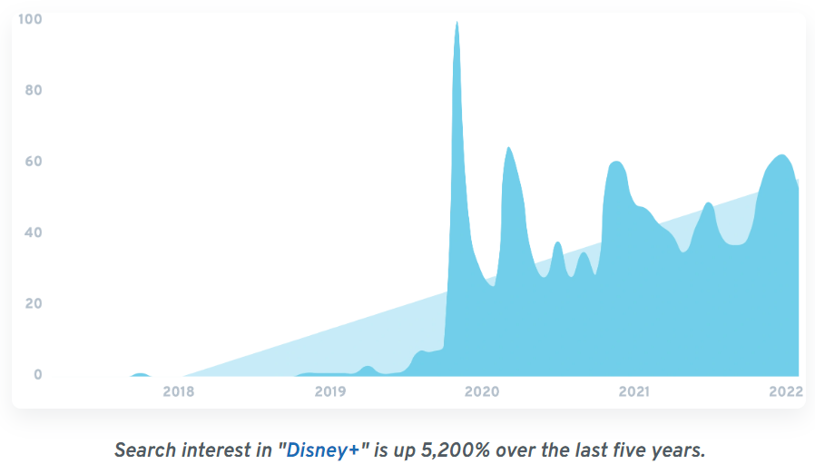
Streaming Trends and Wars
MENU
ANALYSIS
CONTACT
background
In 2021, HBO Max reached 73.8 millions subscribers.
In American, media groups planned to invest 115 billions USD on new content to attract new streaming viewers.
Source: Insider, Financial Times

Slide 9
Streaming Trends and Wars
MENU
ANALYSIS
CONTACT
background
In Vietnam, Galaxy Play representatives shared that the number of viewers in this app has risen up to 5 times. Similarly, number of new users has increased 5 times.
In a survey with 412 participants, 67.96% of participants used licensed streaming video on demand services.
Source: INFOQ VIET NAM

Slide 10

market overview and issue
MENU
ANALYSIS
CONTACT
background
film

Slide 11

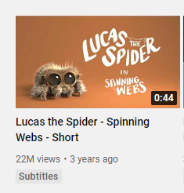
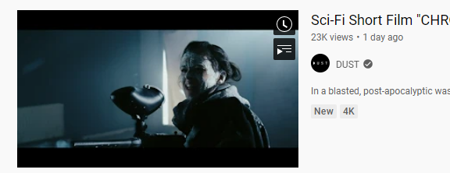
Indie films decentralized release
MENU
ANALYSIS
CONTACT
background
Difficulties in deciding where to release and where to find those films.

Slide 12
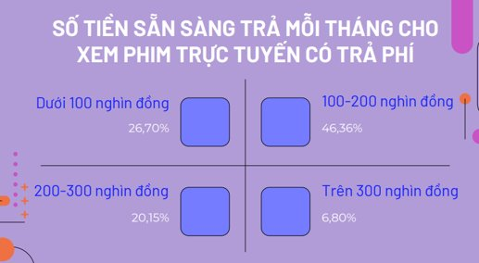
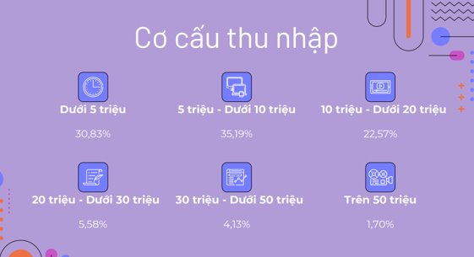
MENU
ANALYSIS
CONTACT
background
low-income people
payment
Source: INFOQ VIET NAM​
Unwillingness to pay high monthly charge for entertainment services especially after pandemic.

Slide 13
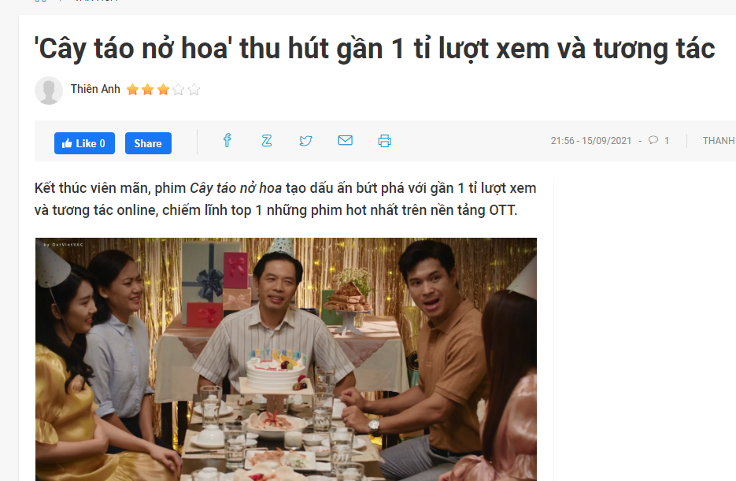


MENU
ANALYSIS
CONTACT
background
Vietnamese television series become more popular
Vietnamese television series have been more and more popular and those series were made by different TV stations and parties. Nevertheless, if the customers want to watch several Vietnamese series, they have to pay for several platforms.

Slide 14

competitors
02
MENU
ANALYSIS
CONTACT
competitors
Discover

Slide 15







MENU
ANALYSIS
CONTACT
competitors
More and more countries want to participate deeply in worldwide film industry…
… which resolves in the development of the video streaming services…

Slide 16






video streaming services market
MENU
ANALYSIS
CONTACT
competitors

Slide 17
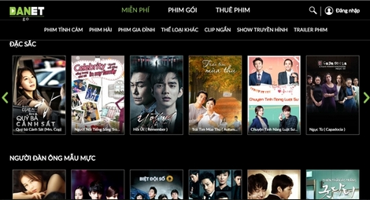

Problem discussion
MENU
ANALYSIS
CONTACT
competitors
Lack of security (pirated films) results in lack of viewers

Slide 18
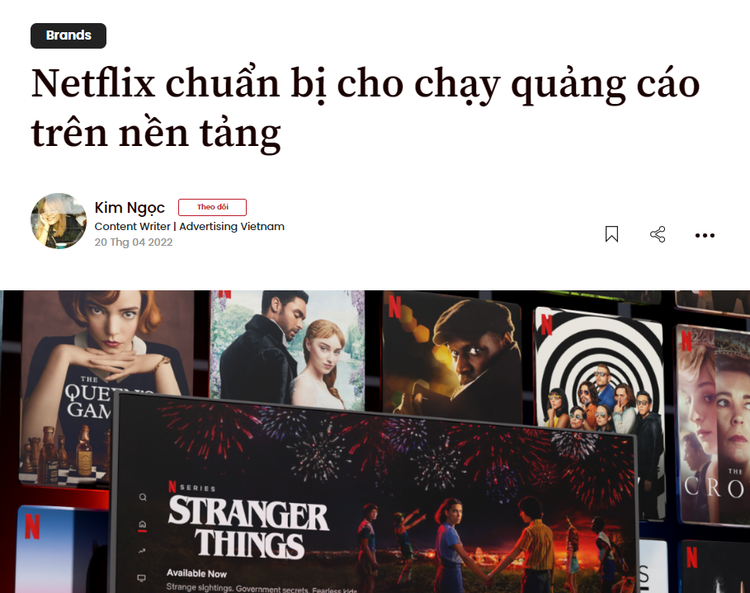
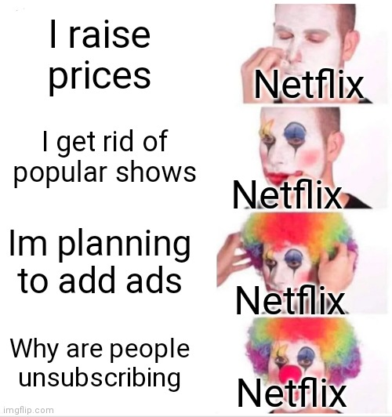
Problem discussion
MENU
ANALYSIS
CONTACT
competitors
Quantity over quality (too many movies but not interesting enough).
Marketing strategy is inefficient (Netflix try to ban sharing account or add ads as a basic subscription but fail).

Slide 19
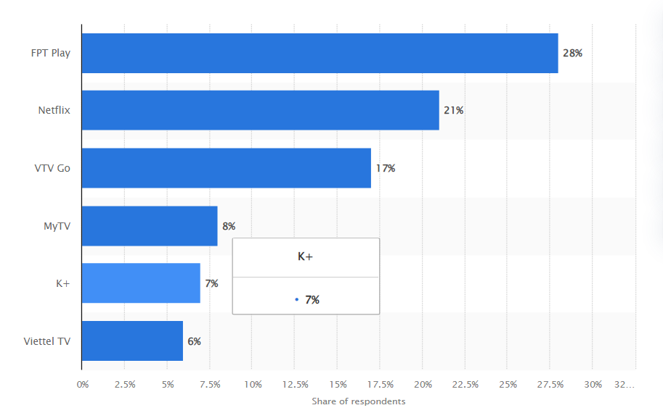
MENU
ANALYSIS
CONTACT
competitors
Is there still opportunity for startup in this field?

Slide 20
opportunity
03
MENU
ANALYSIS
CONTACT
opportunity
How we do

Slide 21

touchable price
MENU
ANALYSIS
CONTACT
opportunity
(!!) In the current market, we have Netflix, Amazon prime, Disney+,… with a price not easily accessible.
However, there are very few Vietnamese films…
⇨ We would like to make an app for streaming familiar films (Hollywood, Vietnamese movies,...)

Slide 22


Improve uploading without any delay
MENU
ANALYSIS
CONTACT
opportunity
(!!) An app like Netflix is uploading new movies very slowly.
⇨ We want to make production that can improve it, we can upload new movies without any delay.

Slide 23
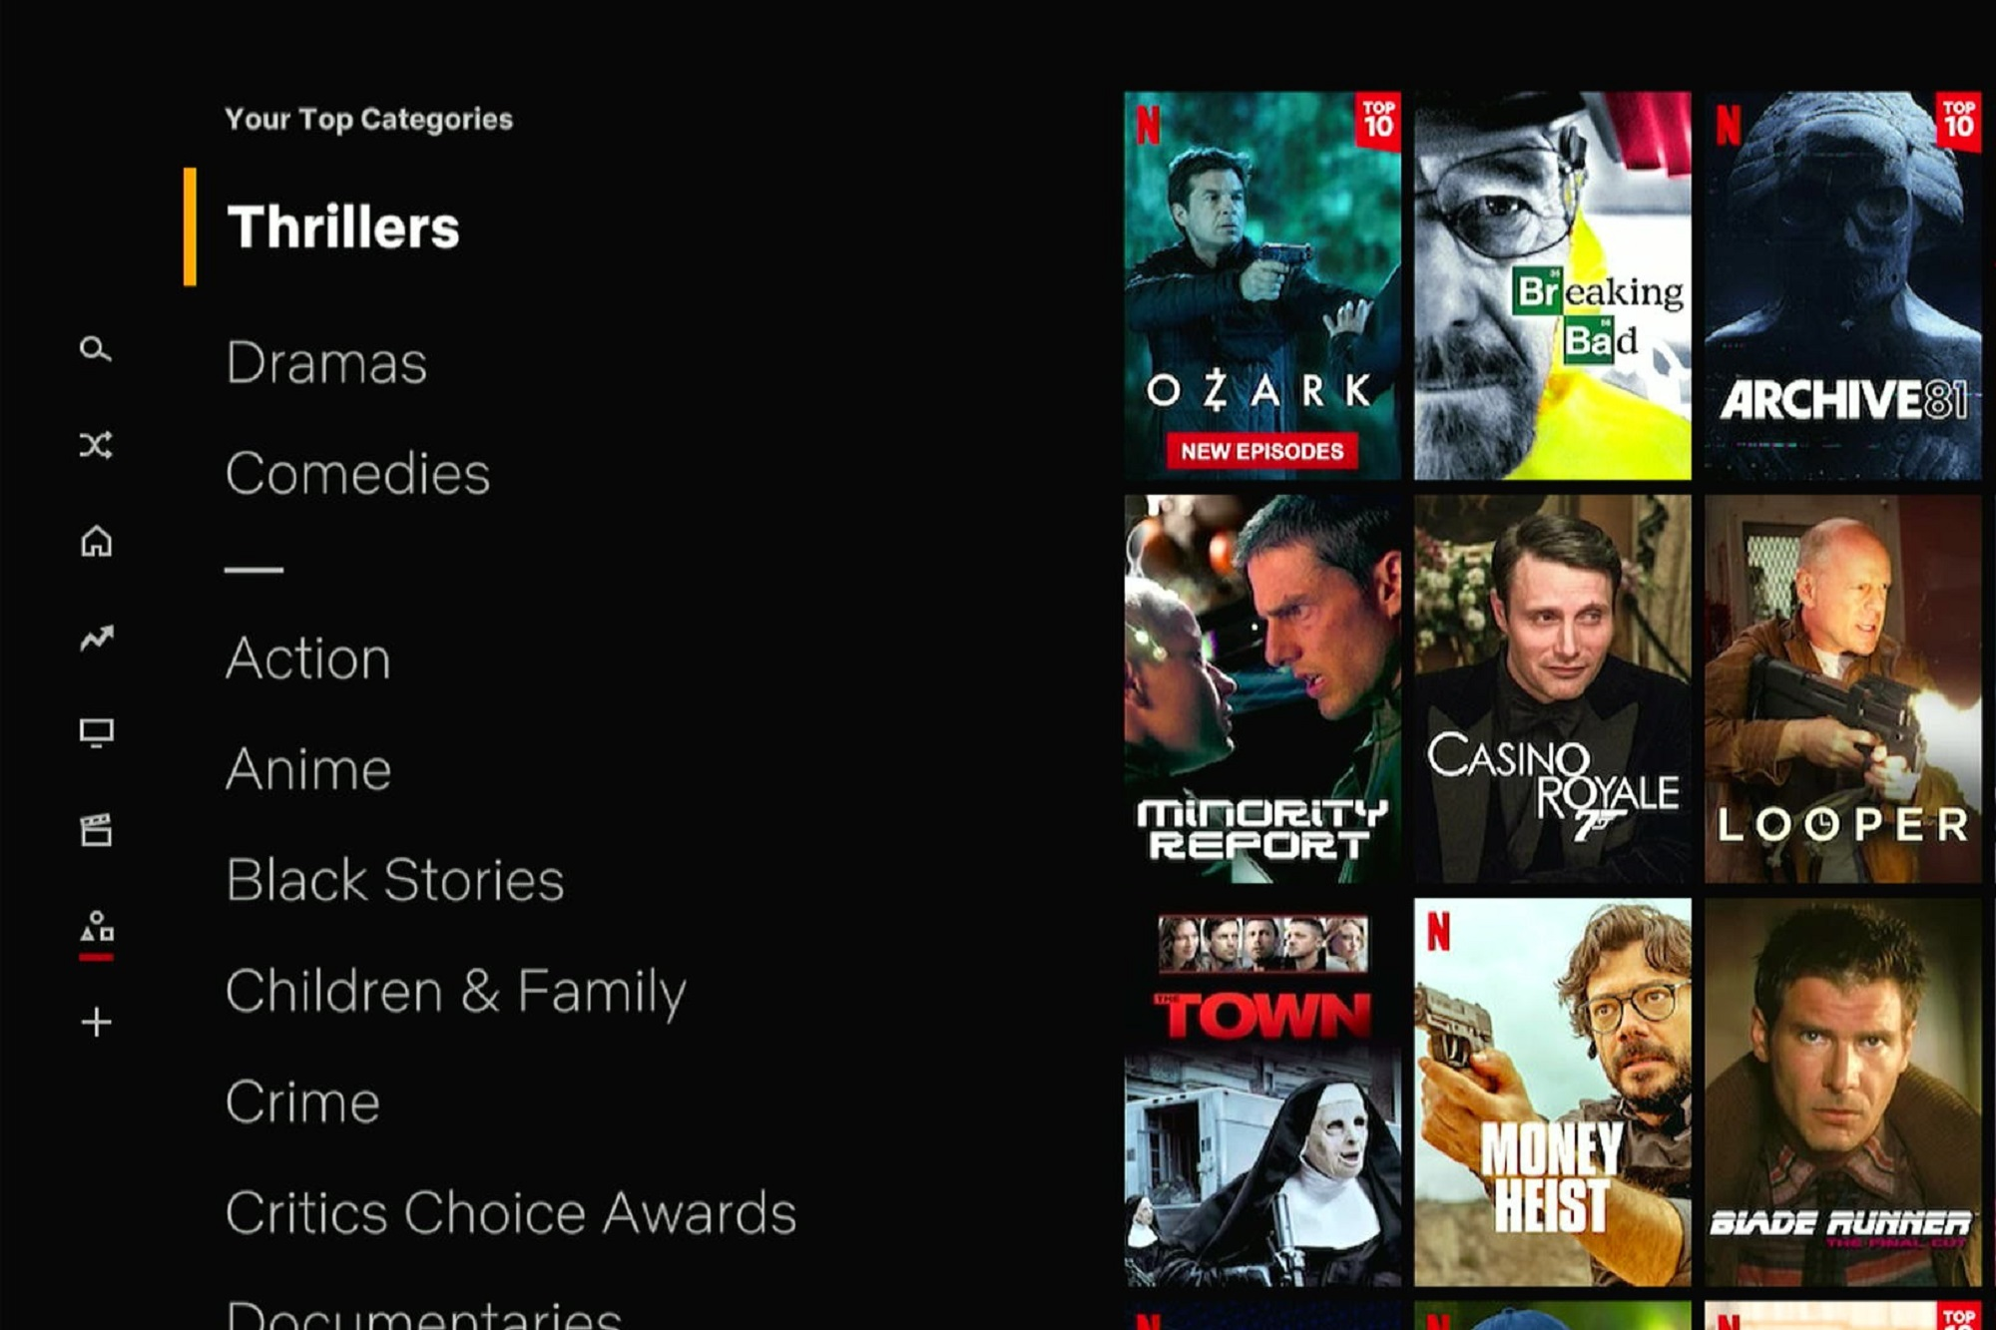
Free trial with full experience
MENU
ANALYSIS
CONTACT
opportunity
(!!) Netflix only gives a free trial for Android users but in limit of 720p.
⇨ Our app can give user free trial with the highest resolution but they only can watch with a few category per week, we change this category at the end of the week.
It would increase the chance of getting the full experience while user using our app.

Slide 24

joint venture connection system
MENU
ANALYSIS
CONTACT
opportunity
(!!) Users have to pay 2 times the money to watch exclusive movies on two different platforms.
⇨ We create an intermediary connection system between distributors. Our system will sub-rent movies from exclusive parties for reruns.

Slide 25

Support indie film makers especially in viet nam
MENU
ANALYSIS
CONTACT
opportunity
(!!) The Vietnamese indie film market has not yet reached a mass audience.
⇨ We create a place to show indie films with full of our support.

Slide 26
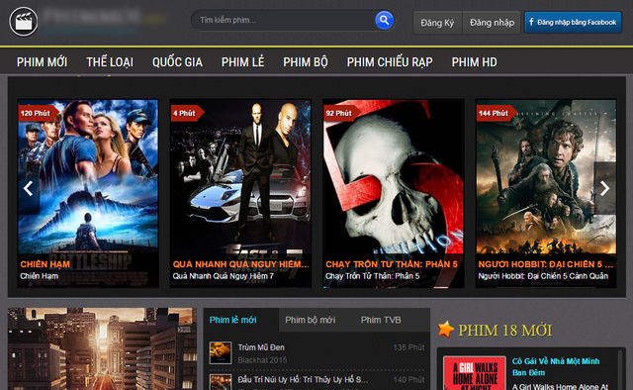
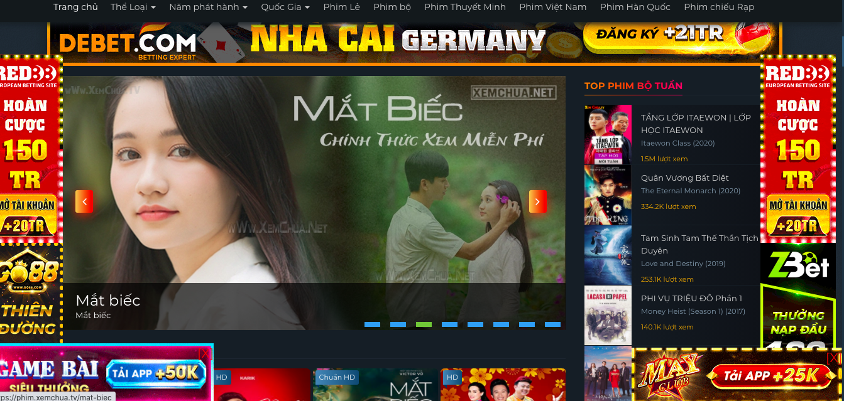
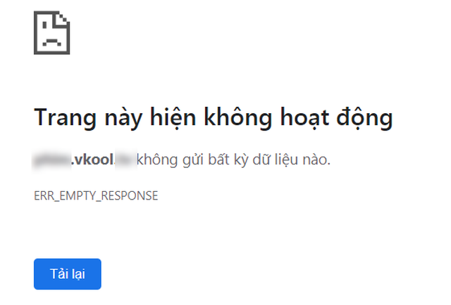
Outbreak of pirated movie websites in vietnam
MENU
ANALYSIS
CONTACT
opportunity
(!!) When watching pirated movies, users face many problems such as: fear of an unreliable platform, watching movies will encounter many ads that greatly affect user experience,...
⇨ We provide users with official high quality movies with no ads.

Slide 27
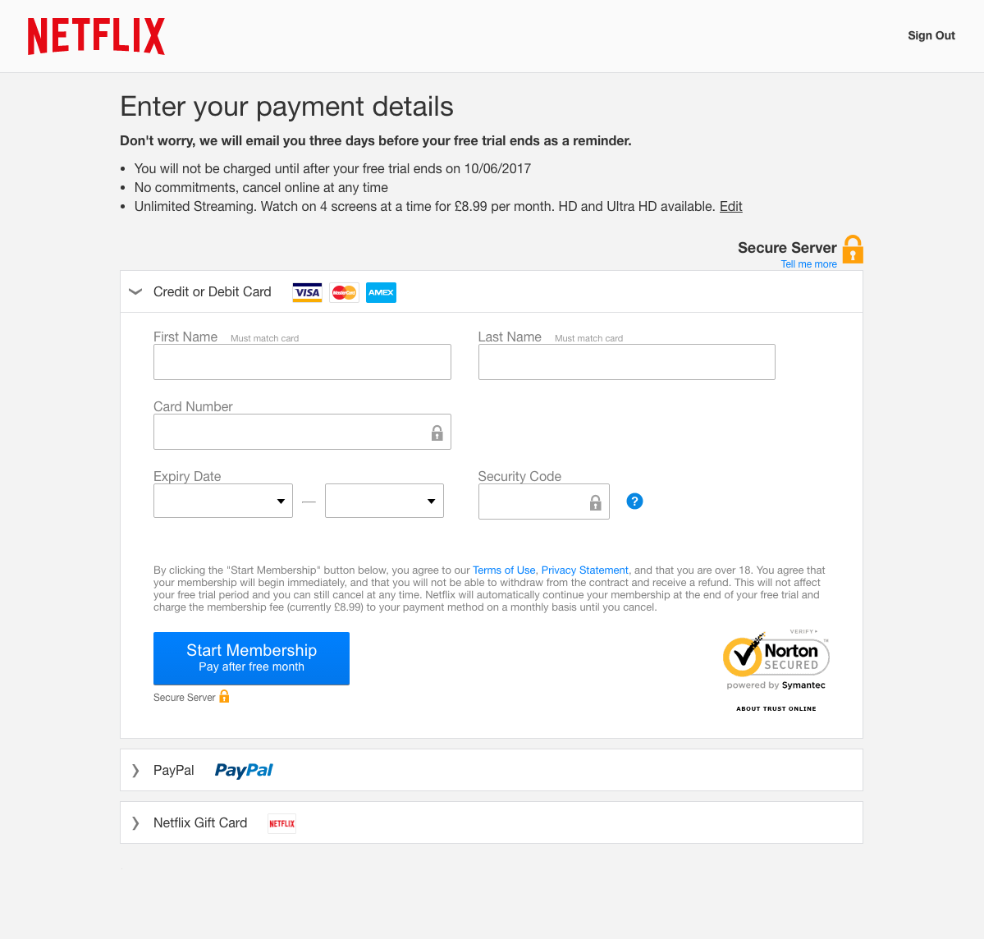
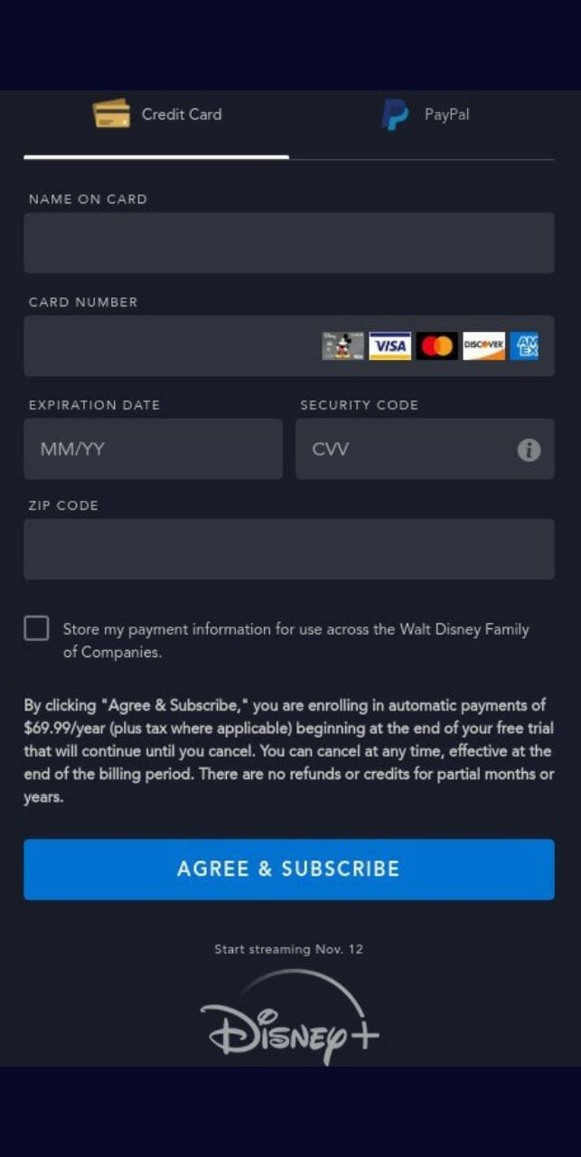
Lack of international payment card
MENU
ANALYSIS
CONTACT
opportunity
(!!) Many people do not have an international payment card.
⇨ We accept local payment card for Vietnamese users.

Slide 28
Business Objective
04
MENU
ANALYSIS
CONTACT
Business objective
Succeed

Slide 29

We discuss and suggest these 3 business goals
MENU
ANALYSIS
CONTACT
Business Objective

Slide 30


1
MENU
ANALYSIS
CONTACT
Business Objective
KPI
User amount
10000 users in the first month of release, appearing on 90% of partner devices. In the following months, growth was 15% in terms of users and 20% in revenue.
37% users pay for Standard Member (50.000 VND)
63% users pay for Premium Member (100.000 VND)

Slide 31



MENU
ANALYSIS
CONTACT
Business Objective
Bringing high-quality movies to every home, for all ages.
2
Connect with major studios to be the exclusive distributor of special movies.
Over 1000 movies, multi-genre, copyrighted, high quality (4K).

Slide 32





MENU
ANALYSIS
CONTACT
Business Objective
3
Easy cross-platform approach
Partner with companies whose platforms can stream high-quality movies
Cooperate with hardware manufacturers to make the app appear on their devices by default.

Slide 33



cloud
MENU
ANALYSIS
CONTACT
Business Objective
Provide a cloud service corresponding to the service package, allowing users to save movies offline.
The higher the subscription service is, the higher the resolution can be saved.
1080p
4.5 GB
Time: 90 mins
… So that users can watch from anywhere without 4G/5G

Slide 34
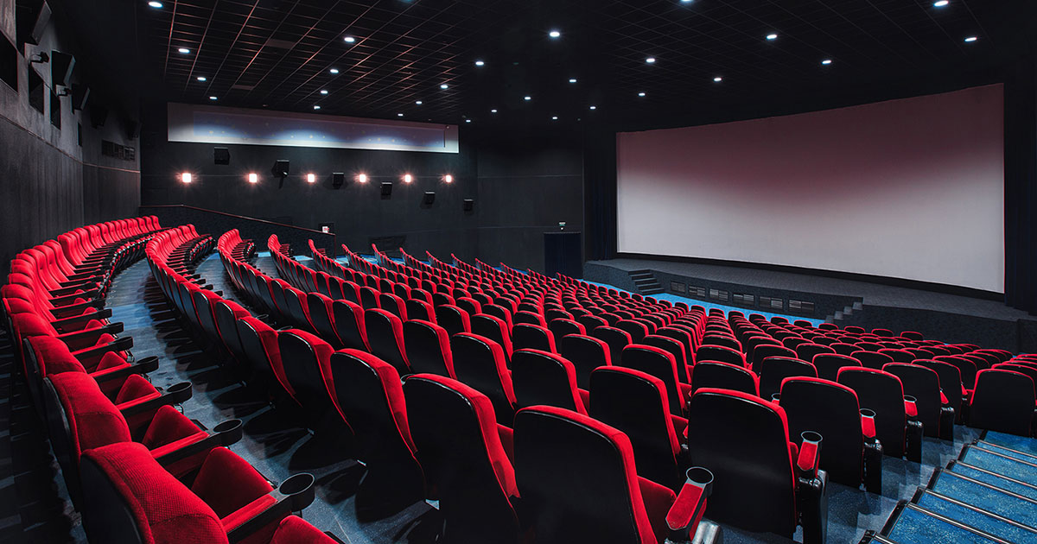
Like at theatre!
MENU
ANALYSIS
CONTACT
Business Objective
Users can order food and drink like in a movie theatre, then there will be a shipper to deliver to your place
⇨ Bringing users a cinema-like experience at home

Slide 35


Support deaf & blind people
MENU
ANALYSIS
CONTACT
Business Objective
Added support for audio descriptions, narration has audio descriptions of visual elements.
⇨ For deaf or blind people who want to enjoy movies.

Slide 36
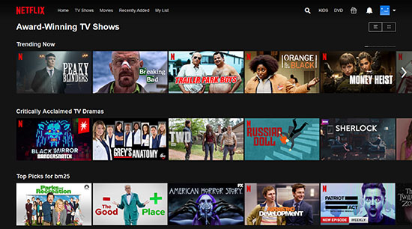
refund
MENU
ANALYSIS
CONTACT
Business Objective
Movie Refund is allowed with these conditions:
- First 15 minutes 1.0 speed no fast forward.
- Not be seen 100%
⇨ For users who bought the wrong movie / heard bad reviews / felt bad when first saw it.
Cancel films payment

Slide 37
THANKS!
MENU
ANALYSIS
CONTACT
Do you have any questions ?

